Slide 1
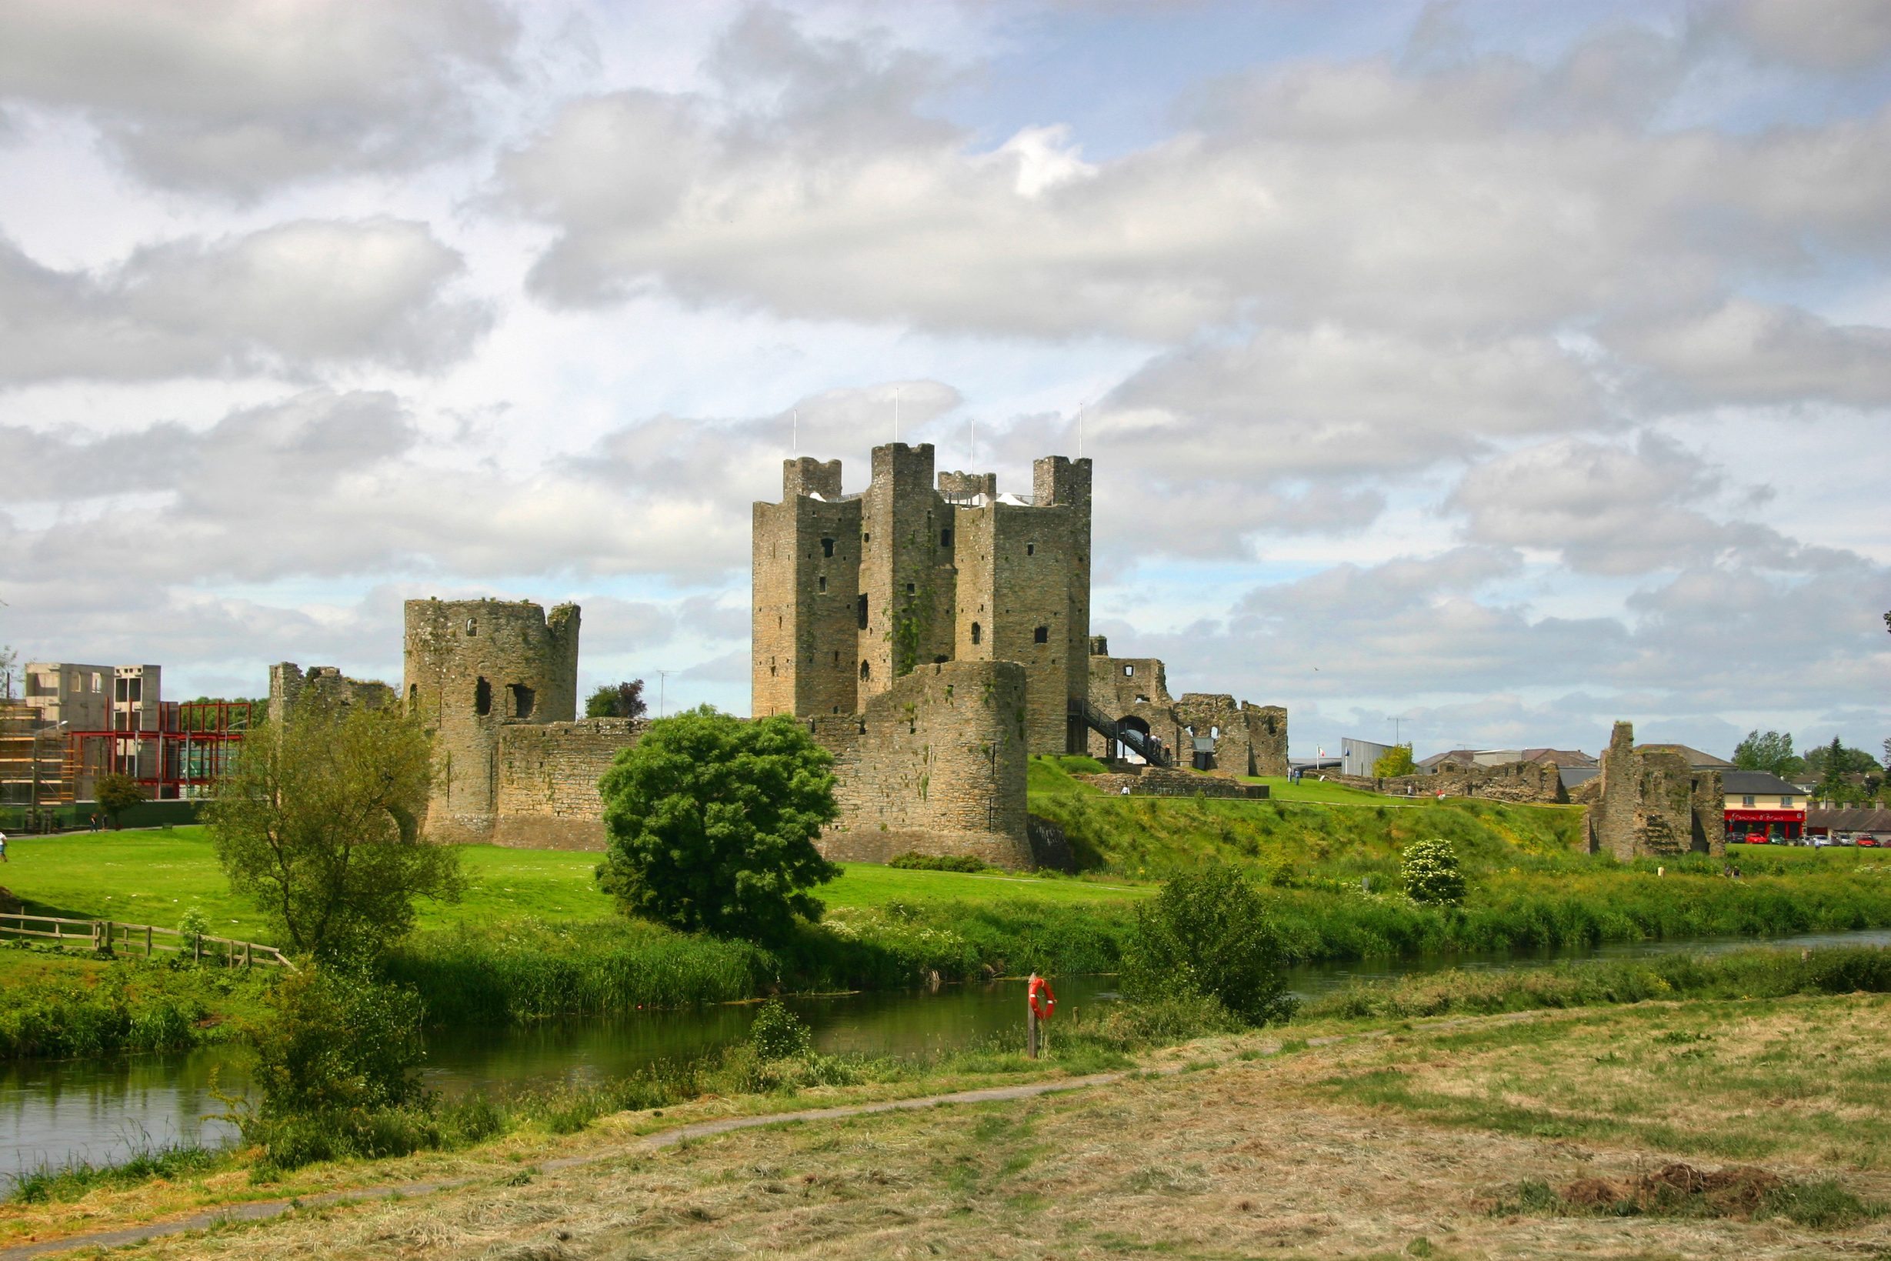



AD 795 to 1500
Chapter 7
THE MIDDLE AGES (NORMAN IRELAND)
the middle ages (norman ireland)
Strand Two: The History of Ireland
@MsDoorley

Slide 2
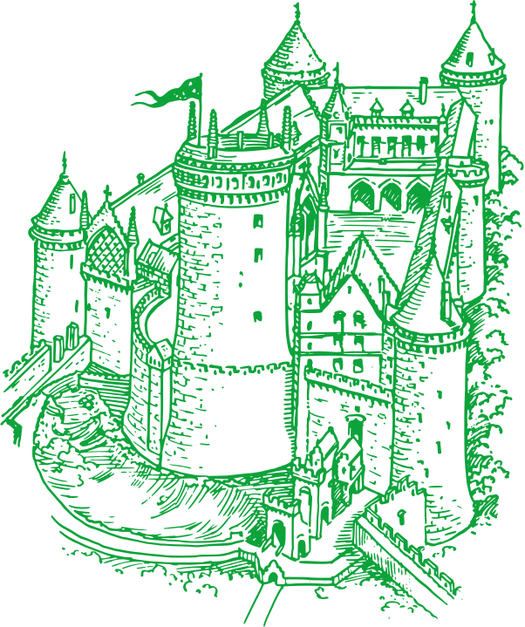
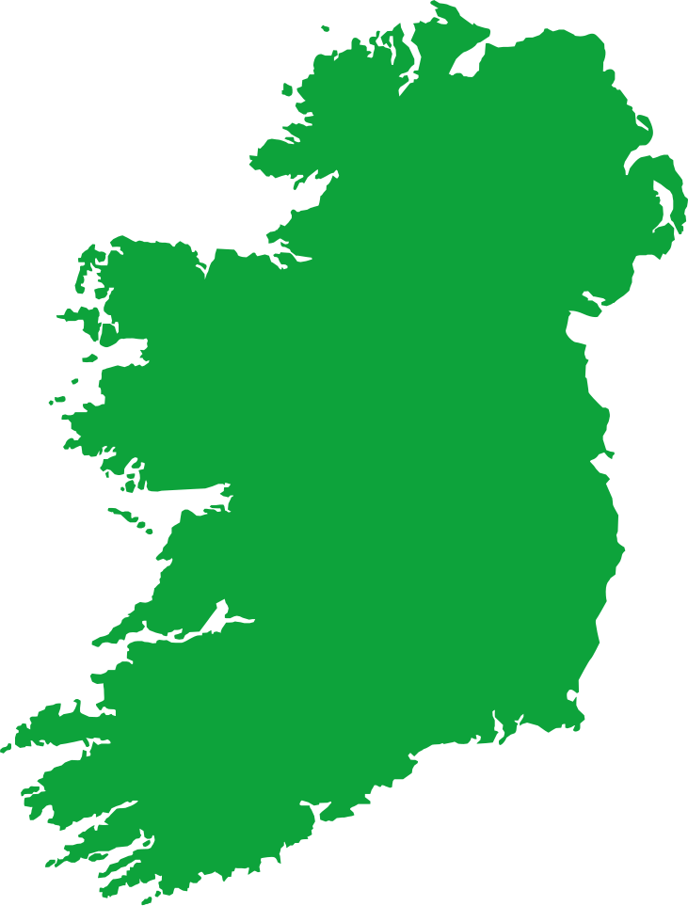
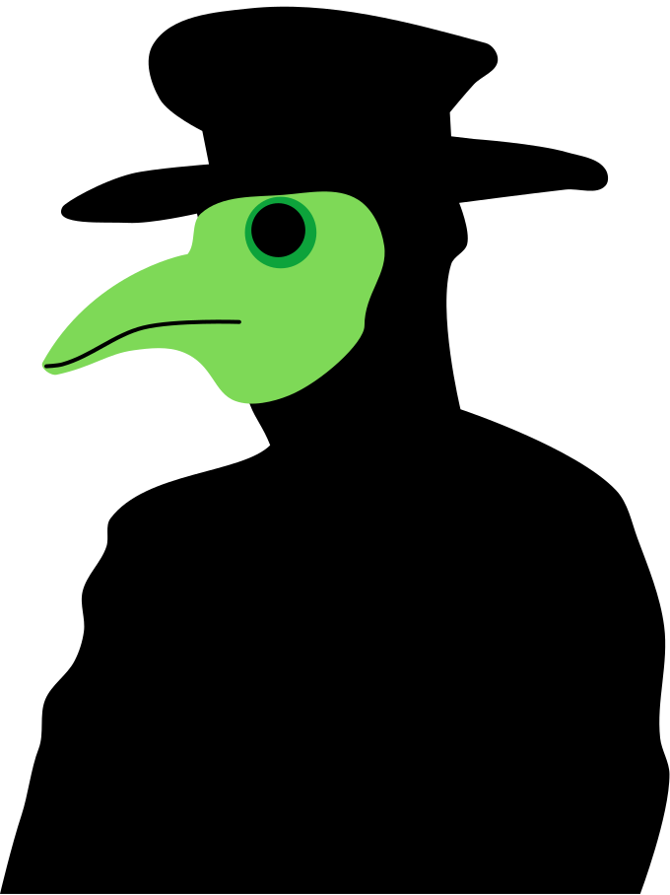


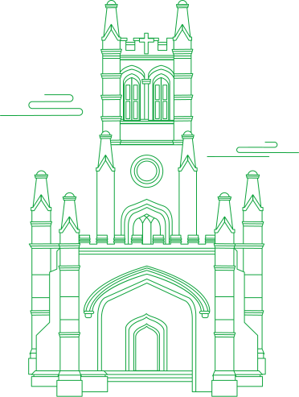
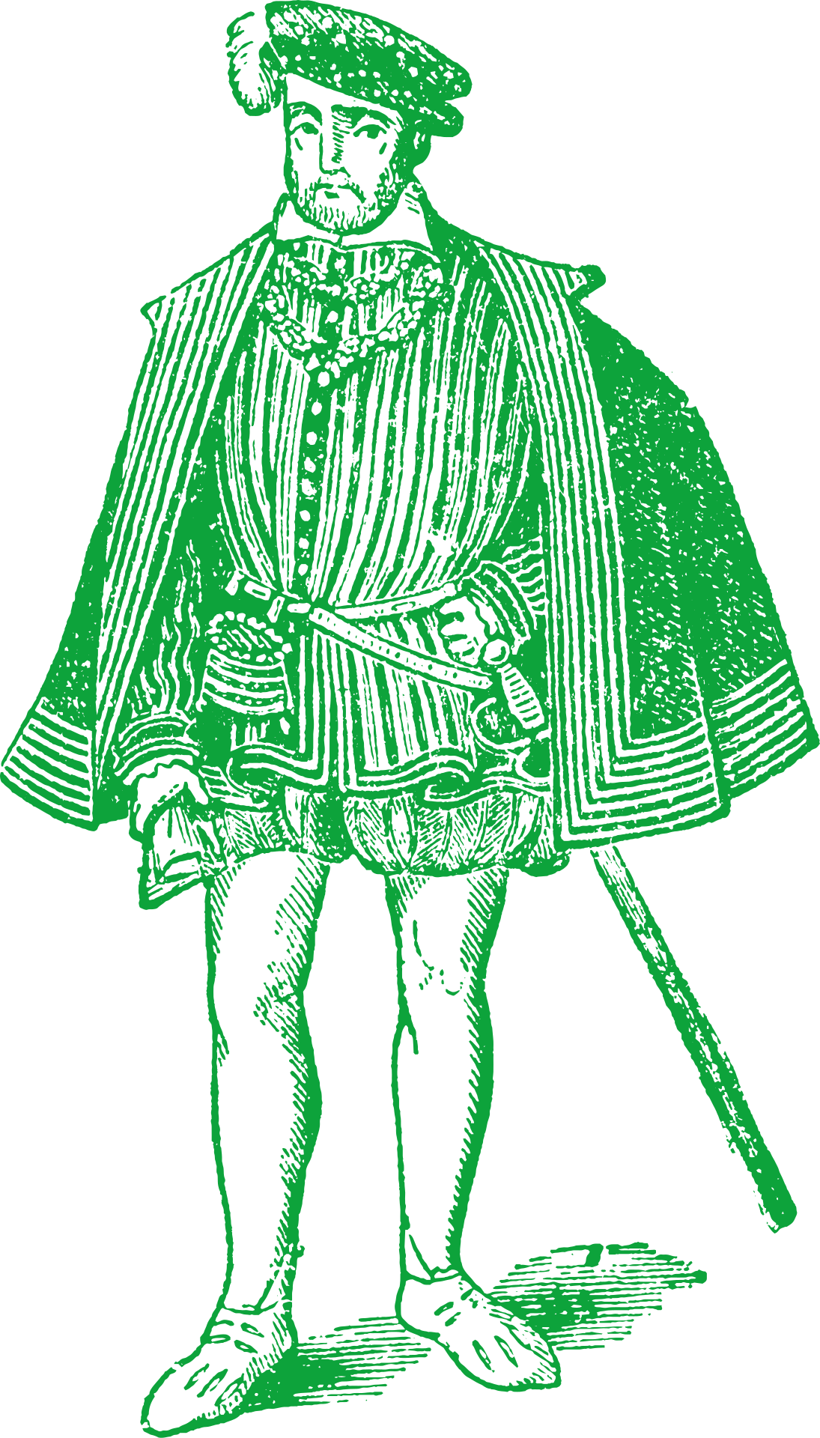
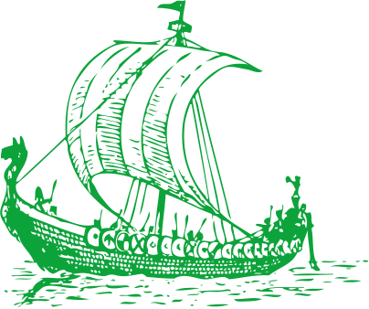

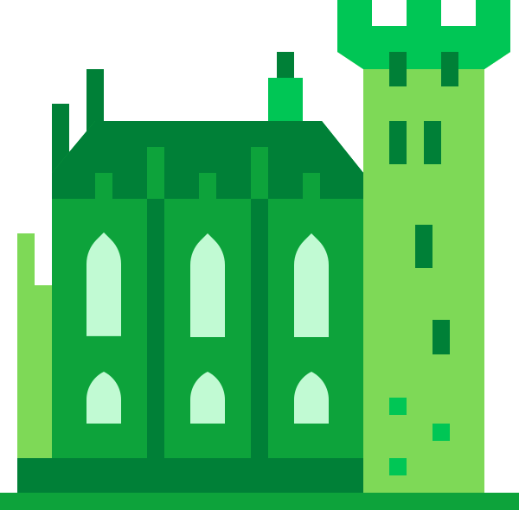
Chapter 7
THE MIDDLE AGES IN NORMAN IRELAND
Paganism dies out in Ireland, replaced completely by Christianity.
The believed foundation of Christ Church Cathedral by Sitric Silkenbeard.
The Black Death ravishes the city.
Mass burials take place in Blackpitts.
795
830
1014
1028
1171
1348
1494
Strand Two: The History of Ireland
Chapter Seven: The Middle Ages (Norman Ireland)
The Arrival of the Vikings in Ireland marked the beginning of the raids..
Brian Boru defeats Viking forces at the Battle of Clontarf.
Henry II of England arrives in Ireland, declaring himself Lord of Ireland.
Ponying's' Law
Irish Parliament cannot pass law without consent of English Parliament.
@MsDoorley

Slide 3
Learning Outcomes
2.1 RECOGNISE how a pattern of settlement and plantation influenced identity on the island of Ireland, referring to one example of a pattern of settlement, such as the growth of towns and one plantation.
3.6 EXPLORE life and death in medieval times.
1.3 APPRECIATE their cultural inheritance through recognising historically significant places and buildings and discussing why historical personalities, events and issues are commemorated.
1.9 DEMONSTRATE awareness of the significance of the history of Ireland and of Europe and the wider world across various dimensions, including political, social, economic, religious, cultural and scientific dimensions.
Strand Two: The History of Ireland
Chapter Seven: The Middle Ages (Norman Ireland)
@MsDoorley

Slide 4
Introduction
The Middle Ages was a hugely important time in Irish history. During this time, Ireland was attacked by the Vikings and later invaded by the Normans. The first towns were set up and many castles were built around the country. Ireland, in this period, was a place of violence and hardship for most people. The island was divided into dozens of different Gaelic Irish kingdoms which all fought each other for control over land and wealth. The invasion of the Normans from England in 1169 would change the island forever.
Strand Two: The History of Ireland
Chapter Seven: The Middle Ages (Norman Ireland)
@MsDoorley

Slide 5
AD 795 to 1500
Chapter 7
7.1: THE VIKINGS IN IRELAND
7.1: the vikings in ireland
Strand Two: The History of Ireland
@MsDoorley

Slide 6
Viking Settlement in Medieval Ireland
  We learned a little about the Vikings arriving in Ireland at the end of Early Christian Ireland.
  Between 795 AD and 850 AD, they had established settlements in Ireland. Originally, these longphorts were bases for attacking the native Gaelic Irish but soon developed into centres for trade and commerce.
  The first Viking settlement was founded in 841 on the south bank of the River Liffey. Dubh linn (dark pool) would later develop into modern day Dublin. Other Viking settlements included Cork, Waterford, Wexford, Limerick and Lough Foyle. By the mid tenth century, Viking raids in Ireland had died out and Viking settlements became a part of Irish life.
  The Viking town at Dublin was protected by a ditch and earthen mound with a high wooden fence. By the late 11th Century, stone walls were built around Dublin.
  The site at Wood Quay has provided evidence such as coins, swords and different crafts dating back to the time. While there was craftsmen there was also a slave trade.
  The Vikings were converted to Christianity by Irish monks and had their first bishop by 1028. This resulted in the building of Christ Church Cathedral. Ireland at the time was in a constant battle between Irish kings. One of the greatest battles between Gaelic clans and Vikings was at Clontarf in 1014 when Brian Boru defeated Sitric Silkenbeard (his stepson).
Strand Two: The History of Ireland
Chapter Seven: The Middle Ages (Norman Ireland)
@MsDoorley

Slide 7
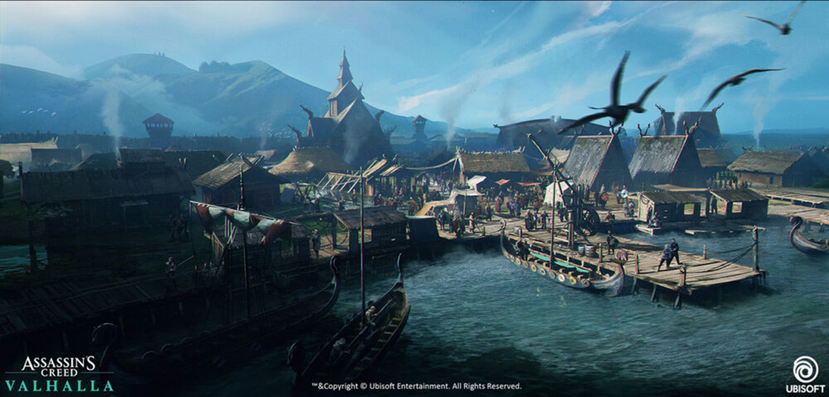
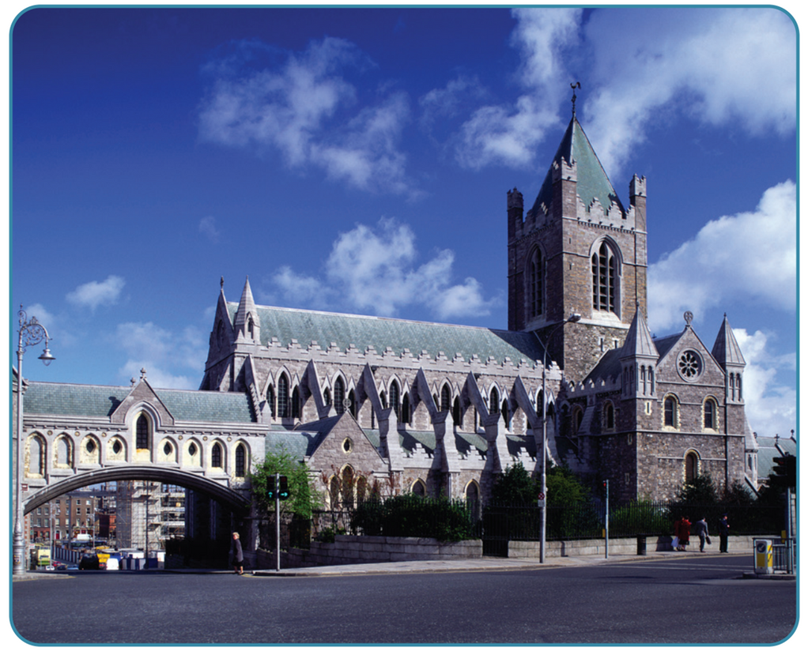
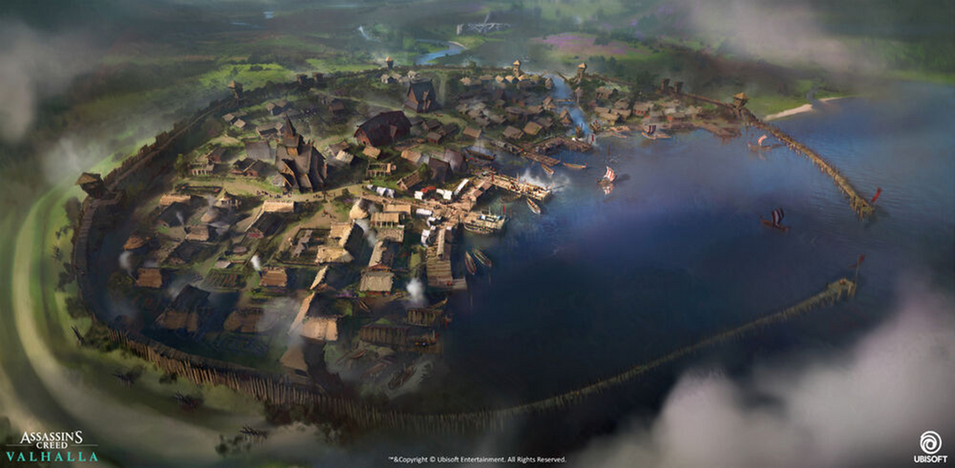
Strand Two: The History of Ireland
Chapter Seven: The Middle Ages (Norman Ireland)
@MsDoorley

Slide 8
Checkpoint (pg. 90, Artefact, 1st Edition)
  Where were the first Viking settlements build and why were they built there?
  Describe Viking Dublin.
  What evidence is there that the town expanded over time?
  What crafts were practised in Dublin?
  Why was Dublin involved in conflict with the Gaelic Irish?
  What happened at the Battle of Clontarf in 1014?
Strand Two: The History of Ireland
Chapter Seven: The Middle Ages (Norman Ireland)

Slide 9
Checkpoint (pg. 90, Artefact, 1st Edition)
  Where were the first Viking settlements build and why were they built there?
    The first Viking settlement was built on the south bank of the River Liffey in 841 AD. It was built near the mouth of the Liffey because it was near the coast and on a river, making it easy for the Vikings to dock their ships and move around.
  Describe Viking Dublin.
    Viking Dublin was protected by an earthen mound and ditch, with high wooden fences.
  What evidence is there that the town expanded over time?
    The evidence we have is that, over time, it developed its own trade market for craftsmen and even its own slave trade. We have found hordes of artefacts such as jewellery as well as the Irish Annals to back this up.
  What crafts were practised in Dublin?
    Coopering, tanning, fishmongering, blacksmith, bakery, cartographers.
  Why was Dublin involved in conflict with the Gaelic Irish?
    A base for the Vikings to attack the Gaelic Irish who were warring with other Gaelic Irish Kings.
  What happened at the Battle of Clontarf in 1014?
    One of the greatest battles between Gaelic clans and Vikings was at Clontarf in 1014 when Brian Boru defeated Sitric Silkenbeard (his stepson).
Strand Two: The History of Ireland
Chapter Seven: The Middle Ages (Norman Ireland)

Slide 10
AD 795 to 1500
Chapter 7
7.2 THE NORMAN INVASION
7.2 the norman invasion
Strand Two: The History of Ireland
@MsDoorley

Slide 11
The Normans Conquer Ireland
  In 1167, the King of Leinster, Dermot MacMurrough was stripped of his kingdom by the High King of Ireland Rory O’Connor. MacMurrough turned to the English King Henry II for help to regain his land, offering to become Henry's vassal in return.
  Henry allowed him to recruit soldiers from his own Norman lords. MacMurrough made a deal with Richard de Clare (Strongbow) for a Norman army in exchange for Strongbow’s marriage to MacMurrough’s daughter, Aoife. and he would become King of Leinster upon MacMurrough's death.
  In 1169, MacMurrough invaded Ireland with a force of 40 knights, 500 foot soldiers and 360 archers. They easily defeated the Vikings of Wexford. The Normans were successful in their military campaign because of their use of horses and archers as well as their better armour and swords. Their battle tactics were also more coordinated than those of the Vikings and Irish armies they faced.
  In 1170, Strongbow arrived with an army of 200 knights and 1,000 soldiers. He and MacMurrough combined their forces and marched on Dublin, taking the city and ending Viking power in Ireland while also reclaiming the kingdom of Leinster.
  In 1171, MacMurrough died and Strongbow replaced him as King of Leinster. Fearing Strongbow would become too powerful, Henry II arrived in September 1171 with his own force of 500 knights and 4,000 soldiers. He wanted to establish himself as the ruler of Ireland and ensure that he controlled both the Normans and Gaelic Irish. Many of the Irish knights swore allegiance to Henry as they thought this might stop the Norman expansion into their territory. Henry gave himself the title of “Lord of Ireland”.
Strand Two: The History of Ireland
Chapter Seven: The Middle Ages (Norman Ireland)
@MsDoorley

Slide 12
The impact of Norman rule on Ireland
The Normans had a huge impact on Ireland after their conquest:
  The Normans introduced English rule to Ireland which would last for nearly 800 years.
  They introduced the feudal system to Ireland.
  They built big castles such as Trim, Carrickfergus and Kilkenny. Smaller castles and tower houses were also built. Towns, manors and villages grew up around these bases of Norman power.
  Farming practices shifted from the Gaelic focus on keeping herds of cattle to growing crops on manors.
  English Common Law replaced the old Gaelic Brehon Law system.
  Norman names became very common that include “Fitz” (which means 'son of') and Burke, Butler, Browne and Barry.
However, the Gaelic Irish also influenced the Normans. Many Norman families intermarried with the familes of native Irish (Gaelic) chieftans. The new families that emerged became known as the Anglo-Irish or the 'Old English'. They adopted the Irish language, dressed like the Gaelic Irish and followed Irish customs and laws in some cases. They became 'more Irish than the Irish themselves', according to an English official in Dublin. Several failed attempts were made to ban these practices among the Norman nobility, such as the Statutes of Kilkenny in 1367.
The Normans never fully conquered Ireland. Gaelic rule remained strong in the north and west of the island. Over the following centuries, the Anglo-Irish lords became increasingly independent of the English king. Direct English control was limited to an area surrounding Dublin known as the Pale.
Strand Two: The History of Ireland
Chapter Seven: The Middle Ages (Norman Ireland)
@MsDoorley

Slide 13
Checkpoint (pg. 66, Artefact, 2nd Edition)
  When and why did the Normans invade Ireland?
  Why did Henry II visit Ireland in 1171?
  Name three ways in which the Normans changed Ireland.
  Why were the Normans in Ireland described as 'more Irish than the Irish themselves'?
Strand Two: The History of Ireland
Chapter Seven: The Middle Ages (Norman Ireland)

Slide 14
AD 795 to 1500
Chapter 7
7.3: LIFE IN NORMAN IRELAND
7.3: life in norman ireland
Strand Two: The History of Ireland
@MsDoorley

Slide 15
Norman Dublin
Dublin became the centre of Norman rule in Ireland. The area surrounding the city (modern Dundalk and Dalkey) was directly under the control of the English king was known as the Pale. Normans outside the Pale soon adopted many Irish customs, including the Irish language as well as intermarriages with the leading Gaelic families – thus becoming the Anglo-Irish. The rest of Ireland (western coast and Ulster) remained under the rule of Gaelic Irish Kings.
Dublin was similar to other towns of the Middle Ages. The walls surrounded the city. Gates controlled the entry and exits of people and a toll was needed to enter the city. A large section of the original wall still exists in Cook Street today. The first prisons were located in the towers at the gates such as Newgate Prison.
Dublin Castle was the seat of English rule in Ireland from the 1200s until 1922. The earlier fortress was replaced with a stone castle in the early thirteenth century. Christ Church Cathedral was rebuilt between 1172 and 1191.
Strand Two: The History of Ireland
Chapter Seven: The Middle Ages (Norman Ireland)
@MsDoorley

Slide 16
Inside and Outside Norman Dublin
Like all medieval cities, Dublin was very unsanitary. To deal with many of these issues, the council passed a law that meant every householder had to clean the street in front of their house. In 1224, fresh water was brought into the city from the mountains using a conduit. In 1305, patrols were set up to try deal with waste. The city was an important trade point for both national and foreign trade with evidence of a wide variety of craftsman found in the city.
After the Vikings were expelled from Dublin, they moved to the North bank of the Liffey – Ostmantown Ostman is an old word for Viking or Oxmantown (modern area of Stoneybatterin Dublin 7).
The Liberties was home to people who did not have to pay taxes but lived without the protection of the walls.
Irishtown was home to the Gaelic Irish.
The Irish language was banned in Dublin but it did not stop the population mixing.
By 1500s, the Irish language was used as much as English – official documents were written in both languages (as they are now).
Strand Two: The History of Ireland
Chapter Seven: The Middle Ages (Norman Ireland)
@MsDoorley

Slide 17
Key events in Norman Dublin
1152 – The Bishop of Dublin was made an Archbishop.
1190 – Dublin was devastated by fire.
1204 – The first fair was held on Fair Green.
1317 – Dublin was besieged by an invading Scottish army. The Bridge over the Liffey was destroyed and the areas outside the walls were set ablaze.
1320 – A university was established at St Patrick’s Cathedral.
1348 – The Black Death ravaged the city. Anyone who wanted to enter the city had to wait outside the walls for three days to prove they did not have the plague. There were mass burials in the Blackpitts area.
Strand Two: The History of Ireland
Chapter Seven: The Middle Ages (Norman Ireland)
@MsDoorley

Slide 18
Checkpoint (pg. 94, Artefact, 1st Edition)
  Why did Dublin need walls?
  Why did the Vikings and Gaelic Irish come to live outside the walls of Dublin?
  What were the Liberties?
  How did the city council try to deal with Dublin’s dirt?
  What goods were (a) imported into and (b) exported from Dublin?
Strand Two: The History of Ireland
Chapter Seven: The Middle Ages (Norman Ireland)

Slide 19
AD 795 to 1500
Chapter 7
7.4: SUMMARY
7.4: summary
Strand Two: The History of Ireland
@MsDoorley

Slide 20
In this chapter, we have learned that...
  The Middle Ages in Ireland were a time of conflict which saw the coming of two groups of outsiders who would have a huge impact on Ireland.
  The Vikings started raiding Irish monasteries in the 790s. From the 840s, they were building settlements along the coasts and rivers. Their largest settlement was at Dublin.
  Dublin grew wealthy from trade and developed into the main town in medieval Ireland.
  In 1169, the Normans invaded Ireland to restore the former King of Leinster, Dermot MacMurrough, to his kingdom.
  They defeated the Vikings and Gaelic Irish and captured Dublin. The city became the base of English rule in Ireland, as the Normans tried to conquer the rest of the country.
  Medieval Dublin was cramped and dirty. Dublin Castle was the centre of the city’s life.
  The Normans changed much of Irish life: they built castles and towns, introduced new legal and farming practices and brought new families and names into the country.
Strand Three: The History of Europe and the Wider World
Chapter Seven: The Middle Ages (Norman Ireland)
@MsDoorley

Slide 21
Reflecting on... Norman Ireland
The Middle Ages was a key turning point in Irish history. The Norman Invasion in 1169 would begin the troubled history of English rule in Ireland and set the stage for nearly 800 years of conflict. We can also see how first the Vikings and then the Normans played an important role in the formation of Irish identity. Neither people remained completely separate from the native Irish and contributed distinct traits which influenced the development of Ireland in the centuries that followed.
Strand Three: The History of Europe and the Wider World
Chapter Seven: The Middle Ages (Norman Ireland)
@MsDoorley

Slide 22
Examination Questions
2022 SEC Q1g
2023 SEC Q1e, Q1f
Strand Three: The History of Europe and the Wider World
Chapter Seven: The Middle Ages (Norman Ireland)
@MsDoorley

Slide 23
Project
Guidelines:
  Length: The depth of your project should reflect about 2-3 weeks of work.
  Sources: Use at least three different sources for your research. These can be books, scholarly articles, or reputable online resources.
  Citations: All information and images that are not your own should be properly cited.
  Mediums: You may choose to present your project in one of the following ways:
    Poster: Your poster should be informative and visually engaging.
    Minecraft or Lego Model: If choosing this option, please also include a brief report explaining your model.
    Painting/Drawing: Your artwork should be accompanied by a description.
    Recycled Materials: Create your model using recycled materials and provide an explanation of your creative process.
Assessment:
Your projects will be assessed based on:
  Research and Content
  Creativity and Presentation
  Understanding of Context
  Adherence to Guidelines
Strand Two: The History of Ireland
Chapter Seven: The Middle Ages in Norman Ireland
@MsDoorley

Slide 24
Project
Historical Sites
Historical Figures
Kilkenny Castle, County Kilkenny
Trim Castle, County Meath
Carrickfergus Castle, County Antrim
Cahir Castle, County Tipperary
Dunguaire Castle, County Galway
Henry II of England
Richard de Clare (Strongbow)
Diarmait Mac Murchada
Aoife of Leinster
John of England
William Marshal
Hugh de Lacy
Gerald of Wales
Maurice FitzGerald
Rory O'Connor (Ruaidrí Ua Conchobair)
Strand Two: The History of Ireland
Chapter Seven: The Middle Ages in Norman Ireland
@MsDoorley

